Slide 1

Title: Global Insights into Greenhouse Gases and Air Quality (A Per Capita Perspective)
Subtitle: A Data-Driven Study (2000–2021) Your Name and Team Details Date

Slide 2

Introduction
Key Challenges: Climate change, air pollution, health issues. Relationship between AQI, income per capita, and emissions.
Objective: Address misconceptions about per capita emissions and AQI. Provide insights to policymakers and researchers.

Slide 3
Research Questions
How do greenhouse gas emissions vary across countries from 2000 to 2021?
What is the relationship between per capita emissions and AQI?

Slide 4

Key Findings
PM2.5 and Ozone: Positive correlation with AQI.
Per Capita Emissions: Limited direct impact on AQI.
NO2: Inverse relationship with AQI.

Slide 5

Datasets Overview
Annual Emissions Dataset (CSV):
Source: Kaggle.
Key Columns: Country, Year, Total, Per Capita Emissions.
Global Greenhouse Gas Dataset (JSON):
Source: KAPSARC.
Key Columns: Country, Year, Substance, Emission Value.
Global Air Pollution Dataset (CSV):
Source: Kaggle.
Key Columns: Country, AQI, Pollutant Levels.

Slide 6
Methodology Overview
ETL Process:
Data Collection, Cleaning, Integration, Transformation.
Database Management:
PostgreSQL for structured data.
MongoDB for JSON datasets.
Visualization Tools:
Tableau for interactive dashboards.

Slide 7

Visualization Insights

Slide 8
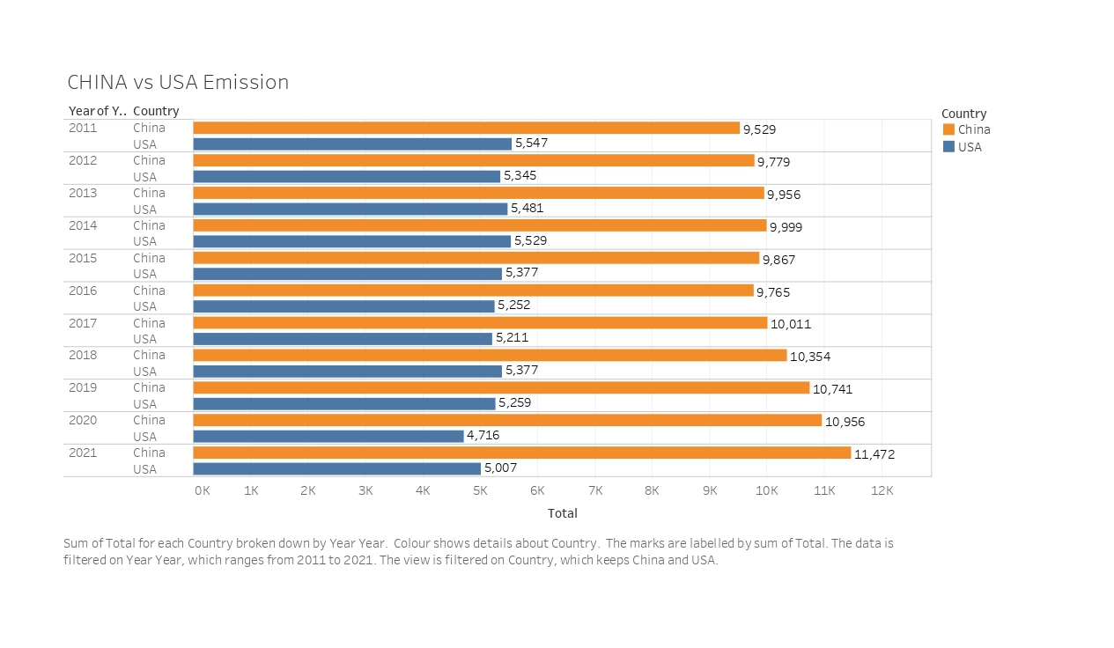
China Vs USA

Slide 9
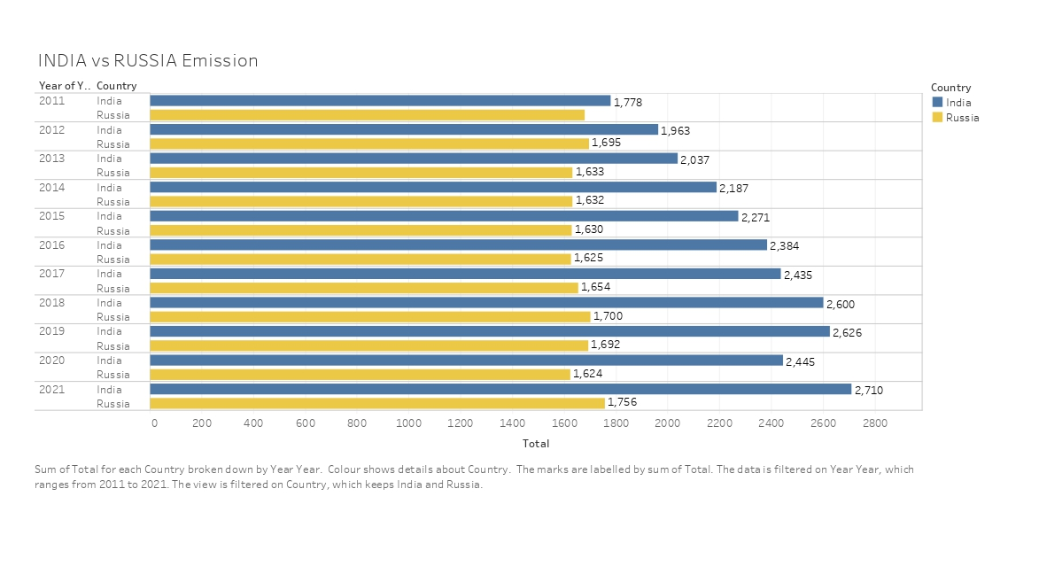
India Vs Russia

Slide 10
Conclusion
Findings:
Developed nations better manage AQI despite high emissions.
Strong correlation between AQI and pollutants.
Need for stricter emission policies and sustainable practices.
Impact: Actionable insights for global policy and environmental awareness.

Slide 11
Future Scope
Integrate healthcare data for disease correlations.
01
Use machine learning for predictive analysis.
02
Support policymakers with actionable insights for emission reduction and AQI improvement.
03

